Slide 1
3-D Solar System
Md. Zahid Hossain Khan - 011142151

Slide 2
Major points
3-Dimensionality
Creating a dynamic background which is ever changing.
Each object of the solar system is different from each
other.
Saturn with its beautiful rings.
Creating the most famous “Halley’s Comet”.
Creating the large scale to almost match the originality.

Slide 3
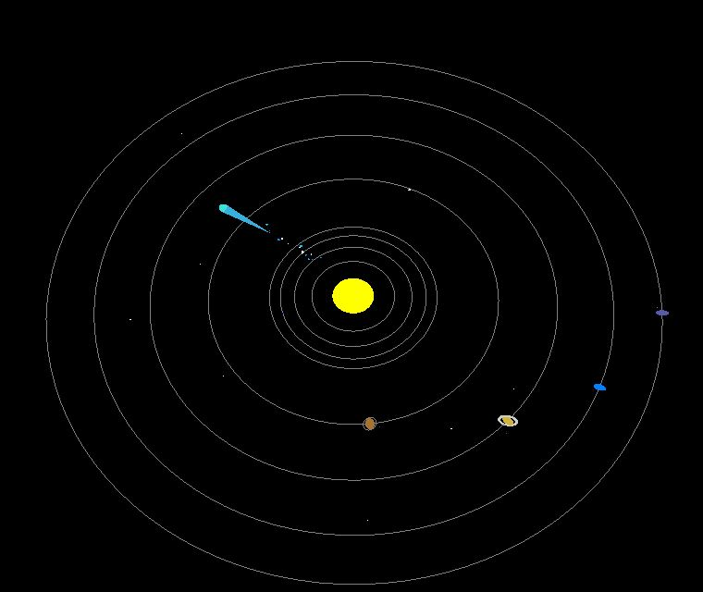
Screenshot of Project

Slide 4
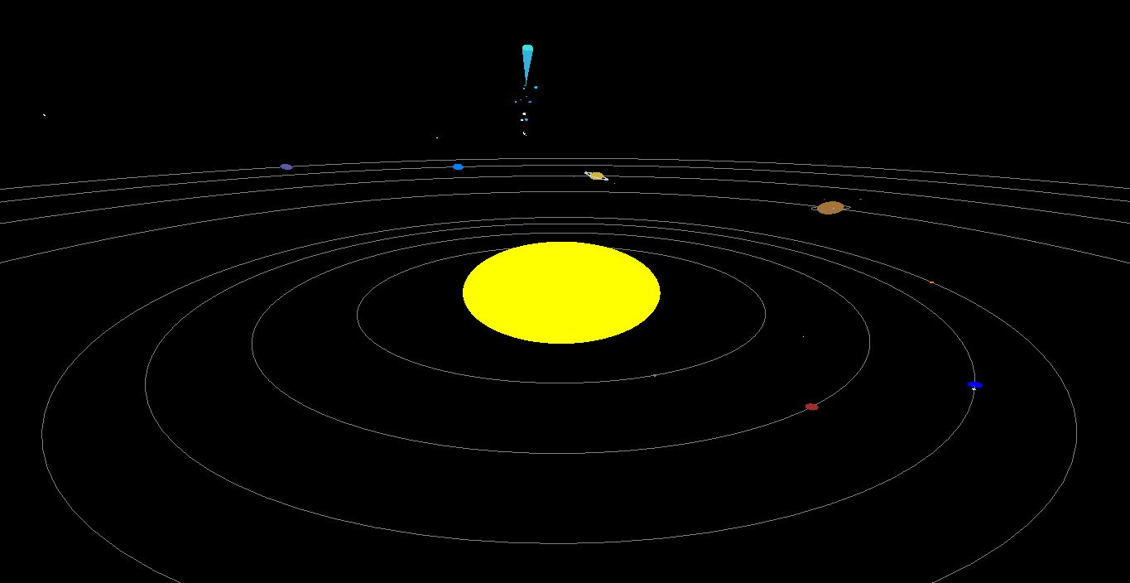
Screenshot of Project

Slide 5
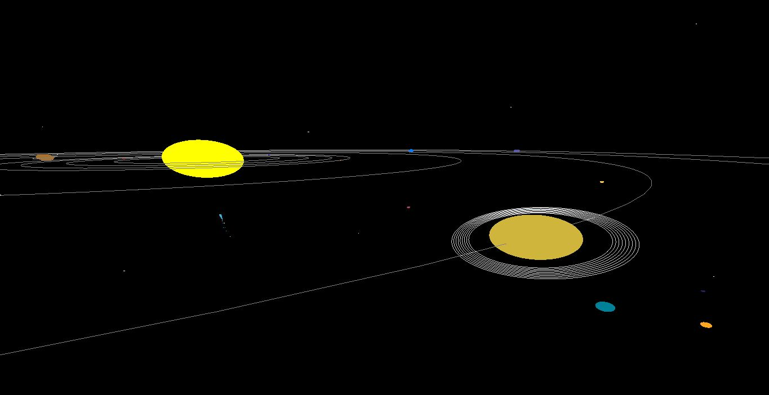
Screenshot of Project

Slide 6
Thank You

